Slide 1


Major Project - 1
Title: Virtual Gym Assistant (MORF)
Presented by:
R177219048 - Arpit
R177219060 - Bhavesh
R177219050 - Arra Reddy
R177219044 - Arihant
Mentored By : Dr Piyush Chauhan

Slide 2
Content
Introduction
Objectives
Methodology
Graphical Analysis
Results
Conclusion
Literature Review
System Requirements
References

Slide 3
Introduction
Problem Statement: Engaging in physical exercises such as weight training and physiotherapy stretching exercises at home requires proper execution and awareness of the exercises. One of the main problems in engaging exercises at home is that there is no proper guidance and feedback provided to align the exercises to the correct movements due to the absence of a physical trainer.
Target Beneficiary: Strength training exercises are essential for human health. However, when per-
formed incorrectly, humans are at risk of injuring themselves. People often invest in costly personal trainers and group fitness classes in order to have access to a fitness expert who will guide the individual in performing exercises safely. We aimed to increase access to affordable trainers by creating a tool that uses deep learning in order to classify exercises as ’correct’ or classify as common types of ’Incorrect.’ positions. These options are inaccessible to individuals with low income and are particularly difficult to use today, in the midst of a pandemic.
Project Scope : This has become especially relevant with the happening of Covid-19 pandemic in 2020 which affected everyone. Throughout this period, people are prevented from socialising, discouraged from going outside, businesses are shut, gyms are closed, and takeaways are cheap. It becomes very easy for people to forget to look after themselves. Especially where people are expected to carry on with all usual responsibilities such as a professional or University work.

Slide 4
Objective
The availability of specialized trainers is limited and in most cases simply too expensive to provide over extended periods of time, and where financial factors are not a barrier, personal privacy preferences can be (i.e., the perception of the potential for embarrassment). A personal trainer significantly decreases the likelihood of inappropriate and even dangerous execution of exercises in either gym environments or at home.
We present ‘MORF’ , a visual monitoring personal trainer for ubiquitous monitoring and assessment of physical exercises performed using standard fitness equipment.
The system provides basic situated visual feedback during exercising and, moreover, performs retrospective automatic assessments of the quality of the performed exercises and suggests measures to improve form. The quality of data in form of live video feed is automatically analyzed, i.e., the skill of the trainee is assessed.

Slide 5
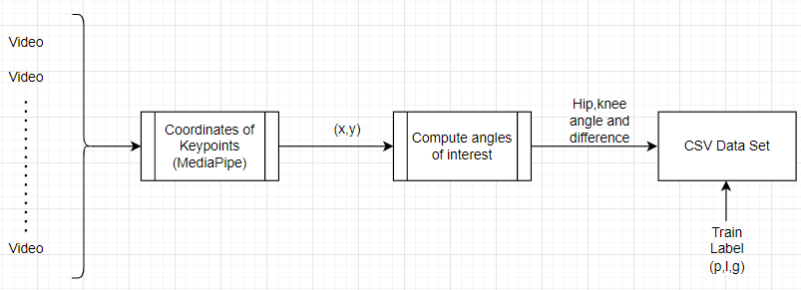
Data Generation - Video Frame Conversion

Slide 6
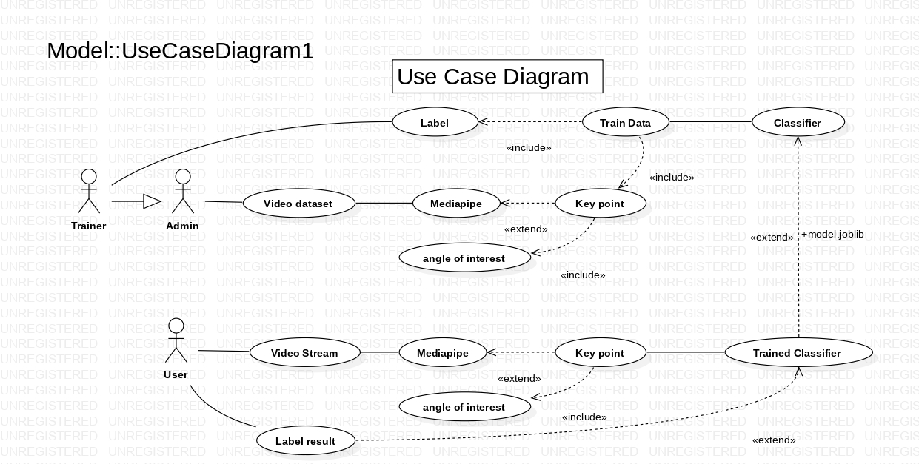
Design diagram
D

Slide 7
Methodology
MediaPipe (Pose detection pipeline):
It is an ML solution for high-fidelity body pose tracking, inferring 33 3D
landmarks and background segmentation mask on the whole body from RGB video frames utilising the BlazePose research.
BlazePose is a lightweight convolutional neural network architecture for human pose estimation that is tailored for real-time inference on mobile devices. During inference, the network produces 33 body key points for a single person and runs at over 30 frames per second This makes it particularly suited to real-time use cases like fitness tracking. The main features include a novel body pose tracking solution and a lightweight body pose estimation neural network that uses both heatmaps and regression to keypoint Coordinates.

Slide 8

Key Points - Coordinates

Slide 9
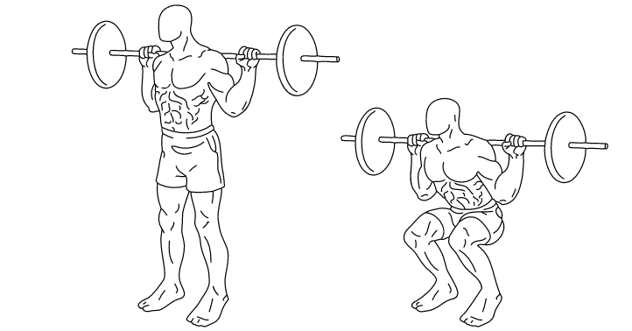
Methodology - Squat Instructions
Live real time analysis by heuristic technique.
Squat instructions: Stand side on with right-side facing towards the camera. Get into the starting position, squeezing your shoulder blades back and squat down.
Avoid:
Leaning forwards at any point
Half-squatting, make sure you go parallel to get the full range of motion

Slide 10
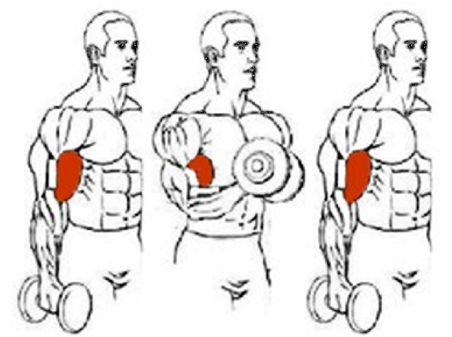
Methodology - Bicep Curl Instructions
Bicep curl instructions: Stand side on with left-side facing towards the camera. Make sure elbows and shoulders remain placed during the exercise and remain upright. Maximise the contraction in the bicep and avoid using momentum

Slide 11
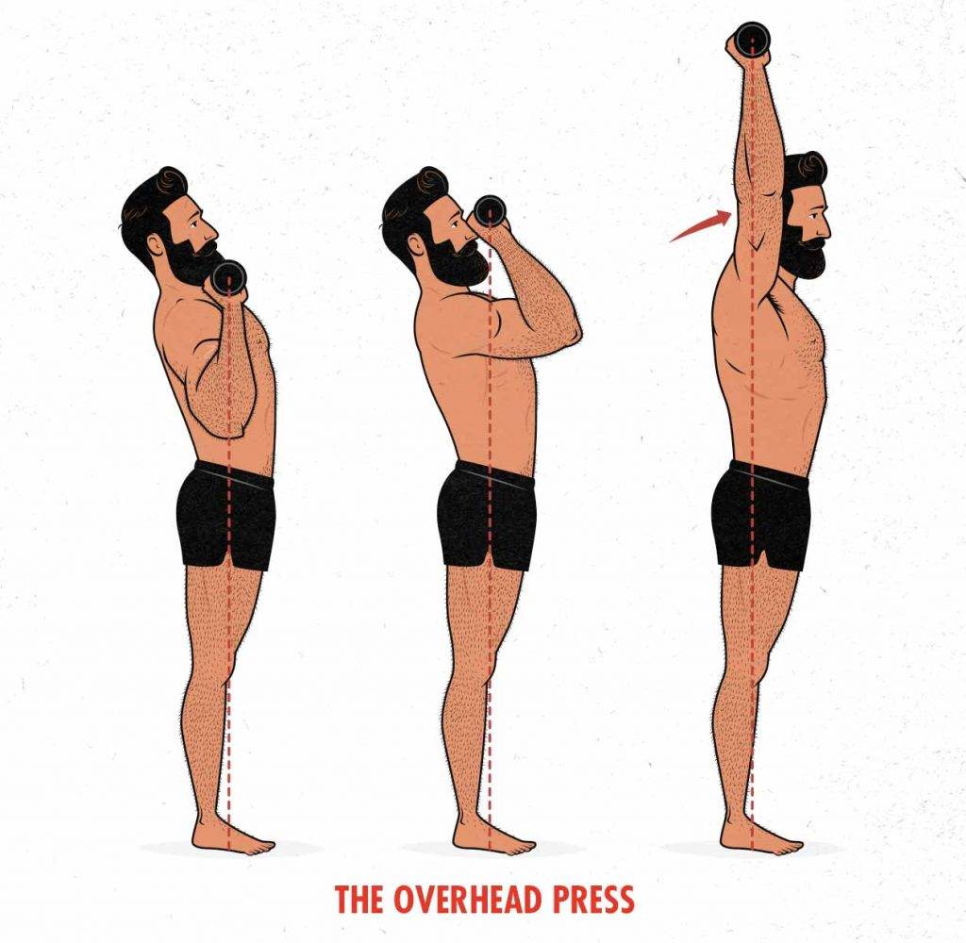
Methodology - Overhead Press (OHP) Instructions
Overhead press instructions: Stand side on with right-side facing towards the camera. Start with hands on the barbell slightly wider than shoulder width apart. Push the bar directly up, moving chin back.
Avoid:
Bending knees for momentum
Bending/arching back
Pushing the bar forwards when pushing up, bar should go directly up

Slide 12
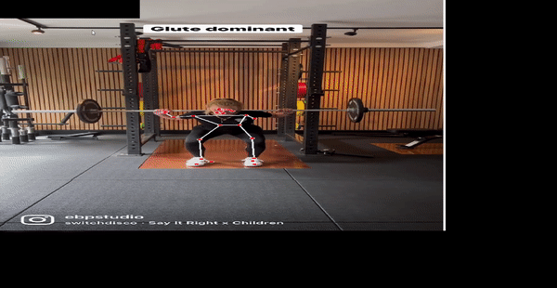
Label Frames & Train Frame Classifier (Phase 1)
We label the individual frames in a video from which a classifier in the sklearn library can be trained.
Output of this phase is labelled frames in a CSV file and trained models in a joblib file.
Following commands are used to classify the squat form frames:
'p' to label a frame as not being parallel
'l' to label a frame as leaning forwards
'g' to label a frame as being good

Slide 13
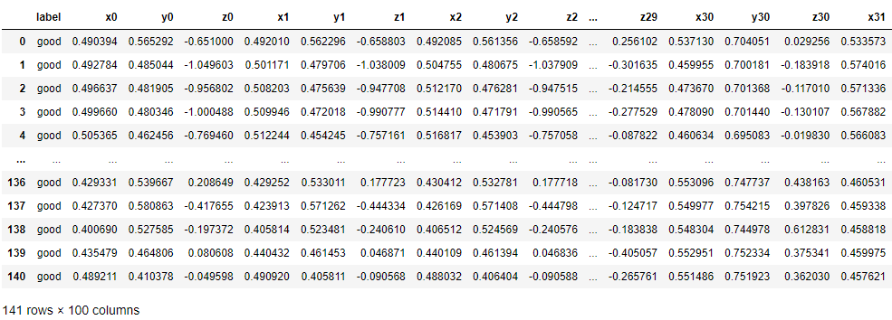
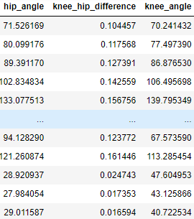
Frame Analysis Of Squats (Phase 2)
Using the three features extracted in label-frames and trained using various classification algorithms:
Hip angle (via keypoints 11, 23, 25)
The absolute difference between knee (23) and hip (25) key points
Knee angle (via keypoints 23, 25, 27)

Slide 14
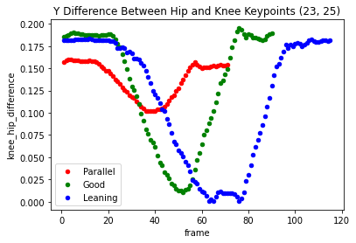
Graphical Analysis and Interpretation
The minima of the red curve is a lot less than the minima of the others. This indicates the squat was not parallel.

Slide 15
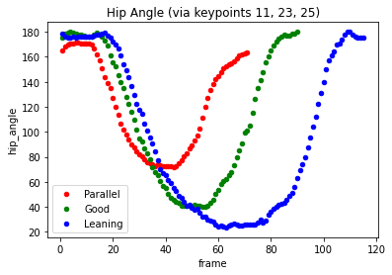
Graphical Analysis and Interpretation
All graphs follow a similar shape, however the minima of the blue curve is significantly less.
This indicates when someone is leaning forward in the squat the hip angle dips below 40 degrees.

Slide 16
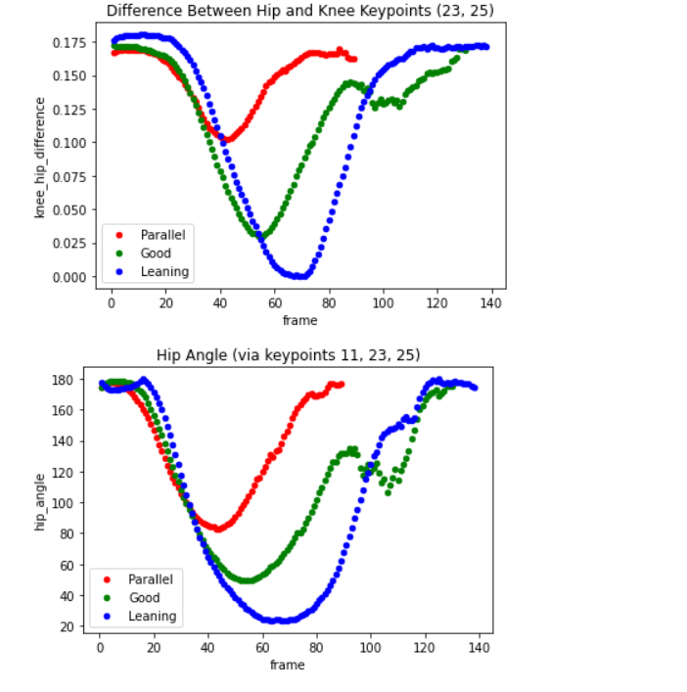
Graphical Analysis and Interpretation
When you do not go low enough or reach parallel in a squat, the length of the exercise tends to be shorter. This is why the red curve is shorter in terms of number of frames as compared to the other curves.

Slide 17
Result (Phase 3)
Analysis of various classification algorithms for exercise form correction. Input: tuples of the exercise videos and trained frame analysis models.
Live frame analysis for feedback demo
Exercise | Algorithm | Accuracy(in %)
Squat | SVM | 99%
 | KNN | 100%
 | Naive Bayes | 98%
 | Neural Network | 99%
Overhead Press | SVC | 85%
 | KNN | 100%
 | Naive Bayes | 97%
 | Neural Network | 97%
Bicep Curl | SVC | 92%
 | KNN | 98%
 | Naive Bayes | 98%
 | Neural Network | 99%

Slide 18
Conclusion
A basic model is developed for detecting squat form inaccuracies using live feed which will allow users to perform the exercise in a better and productive manner.
Can be used in a production setting by deploying it as a web app or as a mobile app which makes it easier for user to analyze their form.
After mid-sem rectification
Addition of other exercises such as Overhead Press (OHP), dumbbell curl etc.
Team has developed error correction model for above listed exercises
Improving model performance and fine tuning.
Team added various new models and worked on improving performance (Neural networks, SVM/SVC, Naive Bayes)

Slide 19
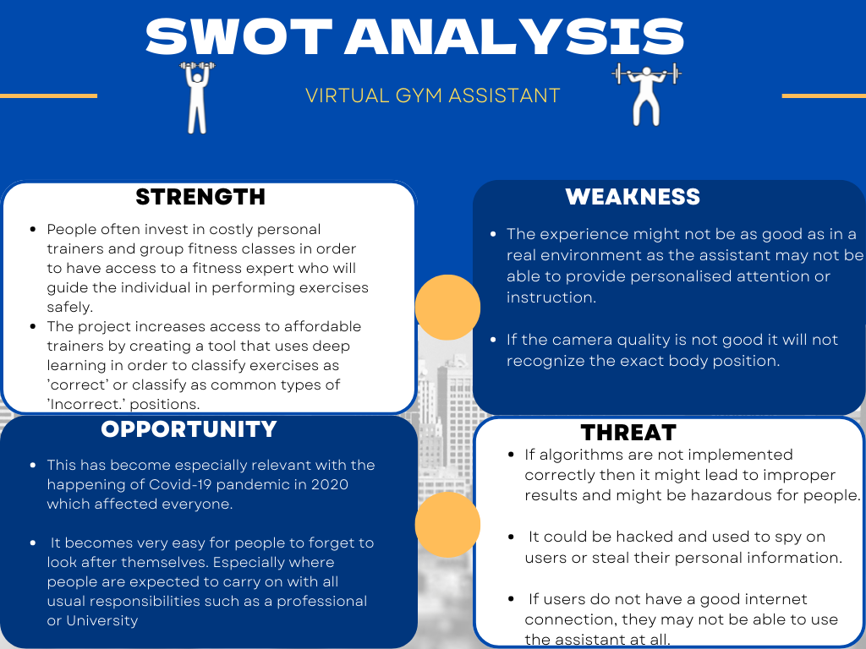

Slide 20
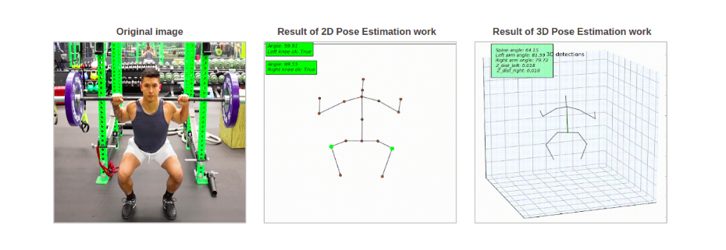
Literature Review
In Paper[1], information about major library used in this project and its functionality is explained. BlazePose is a lightweight convolutional neural network architecture for human pose estimation that is tailored for real-time inference on mobile devices. Main contributions include a novel body pose tracking solution and a lightweight body pose estimation neural network that uses both heatmaps and regression to keypoint coordinates. BlazePose processing time reached 3-4 frames per second, which allows the use in real-time applications. But the accuracy results shown below don’t correspond to the objectives of any HPE task.

Slide 21
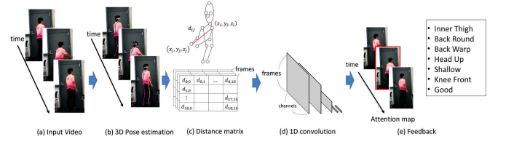
Literature Review
In Paper[2], we’ve discussed the concept that has been used to build this project. In this work, we attempt to automatically detect and correct poor form when working out, utilizing videos. In particular, we target squats and classify the different types.
Figure Description: Overview of our proposed approach. a) Input video. b) We estimate the 3D human pose in each frame of the video. c) For each frame, we calculate the Euclidean distances between all pairs of the keypoints to obtain a symmetric distance matrix, take the upper-right triangle, and flatten it to a vector. d) The vectors for each frame are concatenated together temporally, and processed with a CNN based on 1D convolutions. e) The output classifies the action being done in the video.

Slide 22
Reference
Valentin Bazarevsky, Ivan Grishchenko, Karthik Raveendran, Tyler Zhu, Fan Zhang, Matthias Grundmann. “BlazePose: On-device Real-time Body Pose tracking”
Ryoji Ogata, Edgar Simo-Serra, Satoshi Iizuka. “Temporal Distance Matrices for Squat Classification”
O. Celiktutan, C. B. Akgul, C. Wolf, and B. Sankur. Graph- “Based Analysis of Physical Exercise Actions.”
D. Mehta, H. Rhodin, D. Casas, P. Fua, O. Sotnychenko, W. Xu, and C. Theobalt. Monocular 3D human pose estimation in the wild using improved CNN supervision.

Slide 23
Thank You

